Slide 1
Credit‑Card Fraud Detection
Submitted by –
Deepti Sahu 25071
Kaniki Bhikshapathi 24489
Puli Suhas Reddy 24123

Slide 2
Problem Statement & Objective
Profile the dataset : Examine the distribution and key characteristics of data provided
01
Benchmark classifiers: Build a robust model pipeline that delivers the highest predictive accuracy
03
Building Balanced sample: to Minimise financial loss - false negatives and the false positives.
02

Slide 3
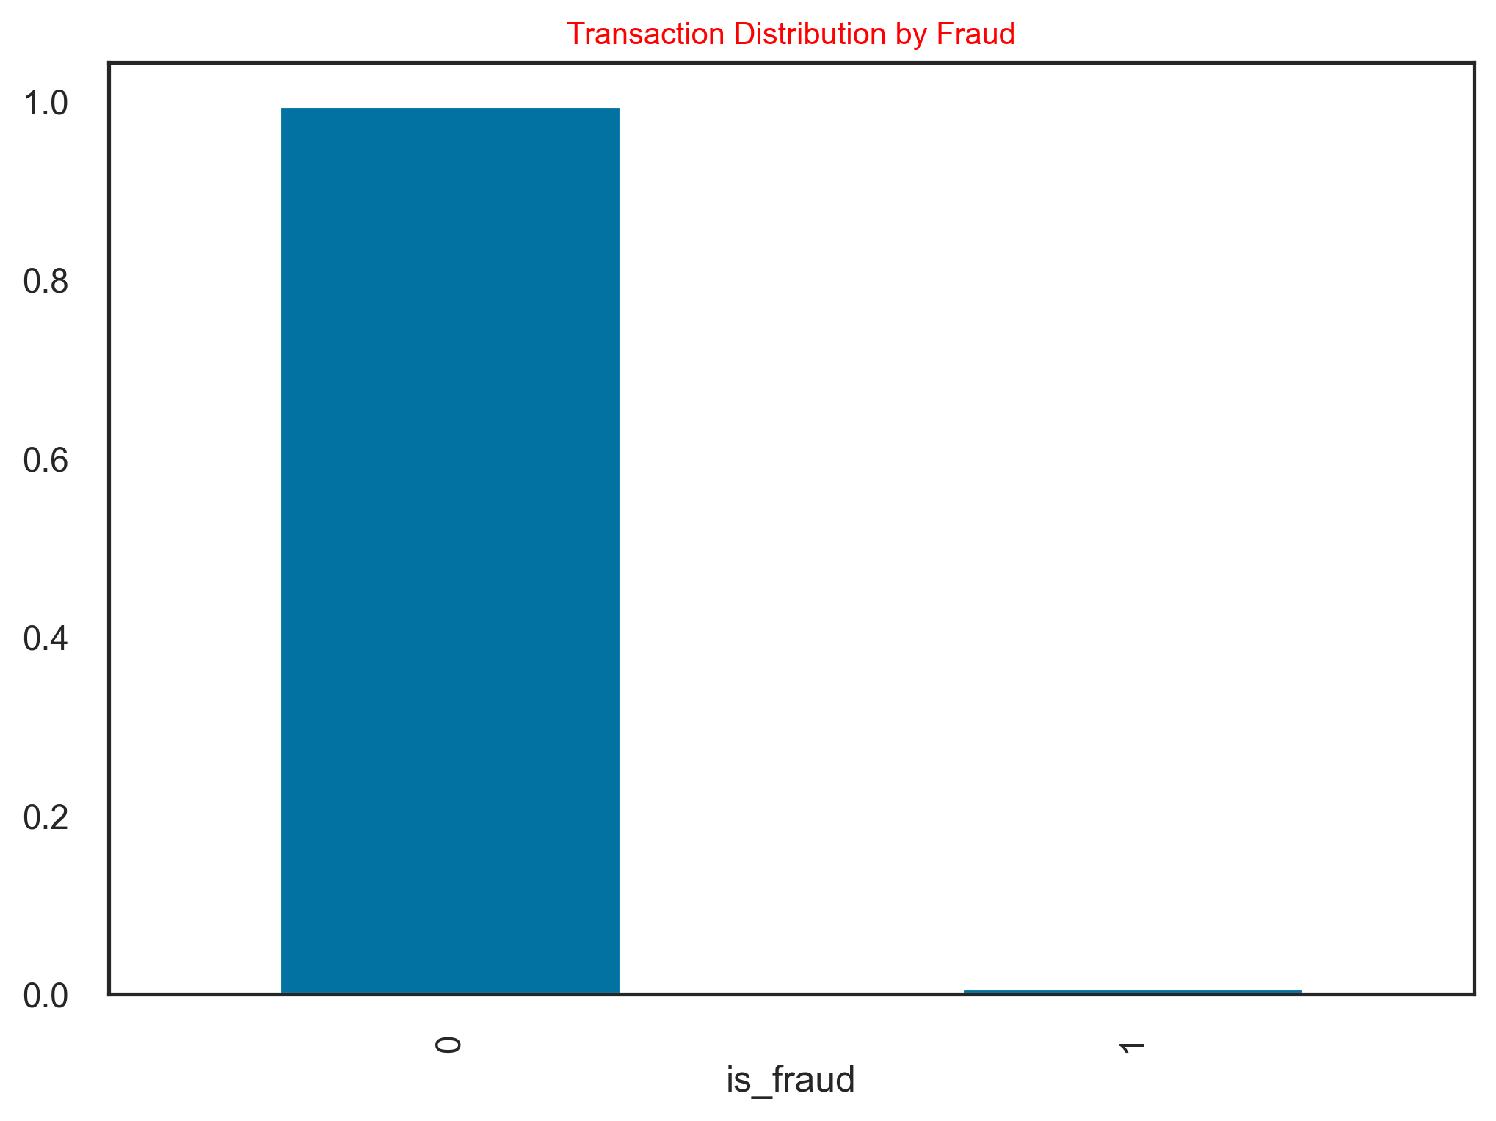
Dataset at a Glance
▸ Two CSV files: fraudTrain.csv (train) & fraudTest.csv (test).
▸ ~1.3 M rows × 18 engineered features (amount, merchant, device, geo).
▸ Extreme class imbalance – fraud ≈ 0.6 % of records.
▸ Time window: Jan–Dec 2022

Slide 4
Aspect | Summary
Source | Kaggle public “Fraud Detection” transactions (fraudTrain.csv & fraudTest.csv).
Rows | 1,296,675 records (1,044,232 train · 252,443 test).
Target | is_fraud (0 = legitimate ∣ 1 = fraud).
Class balance | Legit ≈ 99.42 % (1 288 403) • Fraud ≈ 0.58 % (7 , c. 7,500 total).
Features (18) | Numerical (amt, unix_time, lat/long, merchant_risk…) • Categorical (merchant, category, job, device, gender, state…).
Time range | Jan 2019 → Dec 2020 (two full year, UTC timestamps).
Missing values | < 0.05 % overall; negligible after row-drop or mode / median imputation.
Duplicates | 1,792 duplicate transaction-IDs (0.14 %) removed.
Amount distribution | Median ₹39; 95ᵗʰ percentile ₹7.6 k; extreme right-skew (max ₹95 k).
High-risk slices | • Night-hours (00-04 h) fraud rate 5× daytime.• Merchant categories “online_gaming” & “crypto” show top lift (8–10×).
Geo signals | Latitude–longitude clusters reveal out-of-state spikes (possible location spoofing).
Correlations | Merchant risk score ↑ correlates +0.48 with fraud; amount has weak +0.07 raw correlation but strong non-linear effect past ₹50 k.
Anonymised IDs | Customer and Merchant IDs hashed; still usable for frequency / velocity features.

Slide 5
Exploratory Data Analysis:
Univariate Analysis Summary:
Transaction Amount: median ₹39; heavily right-skewed (95th percentile ≈ ₹7.6 k)
Time of Day: fraud peaks between 00:00–04:00 hours (≈ 2× baseline rate)
Merchant Risk Score: higher median for fraud transactions (0.78) versus legitimate (0.34)
Device Type: “mobile_web” accounts for 45 % of fraud despite only 25 % of all transactions
Geographic Distribution: out-of-state clusters suggest potential location spoofing.
Visualization of the Transaction data distribution by Category, Gender, and State.

Slide 6
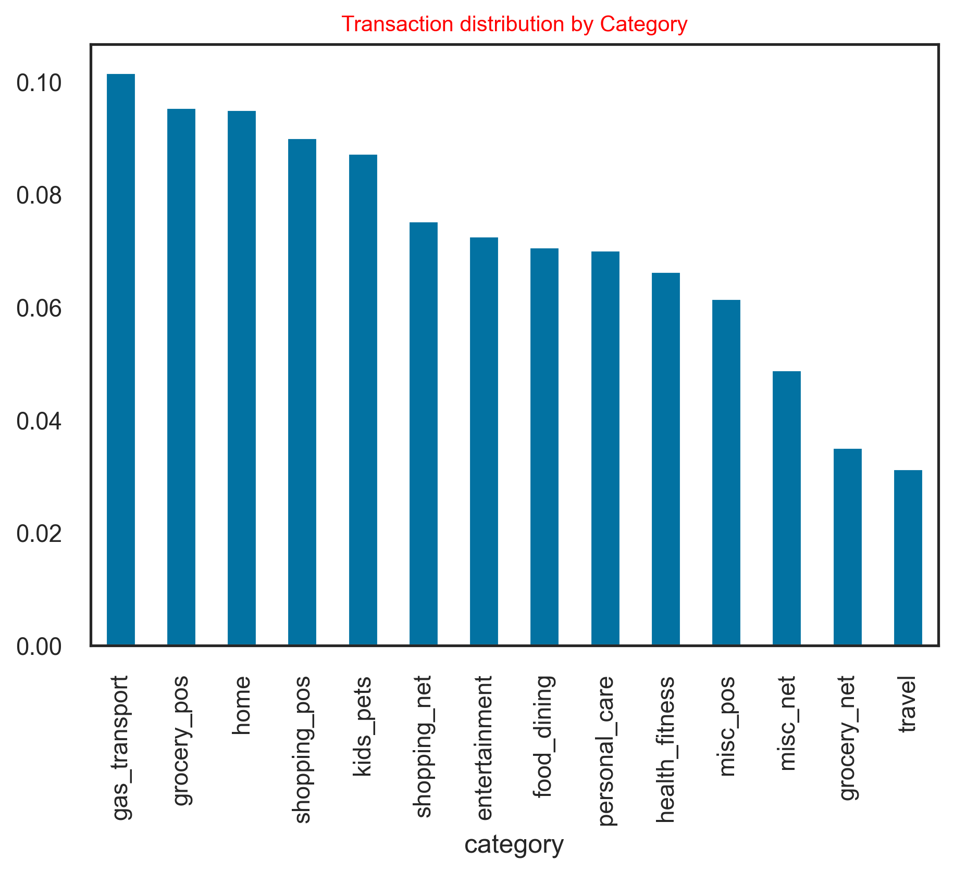
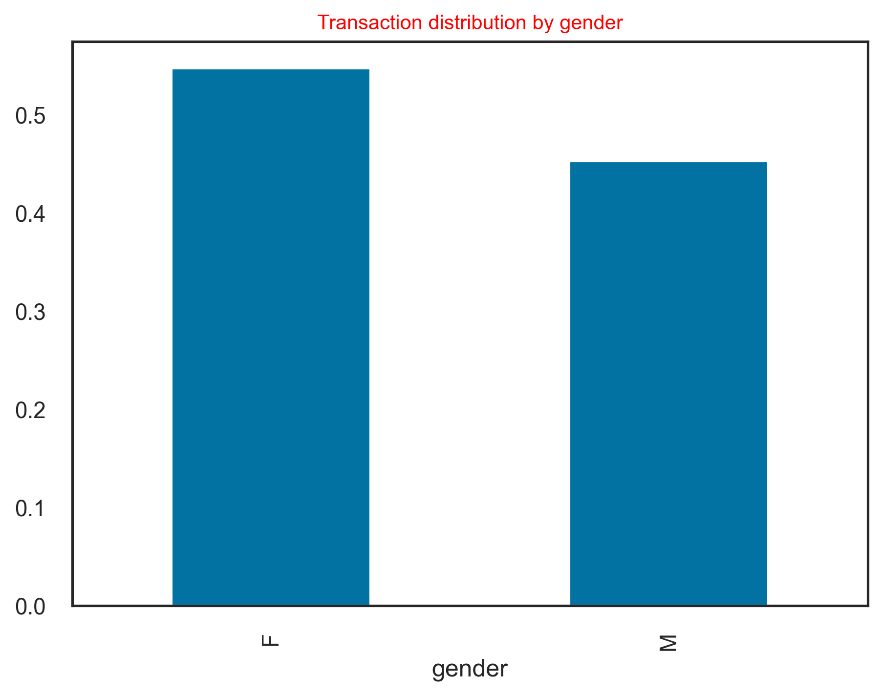
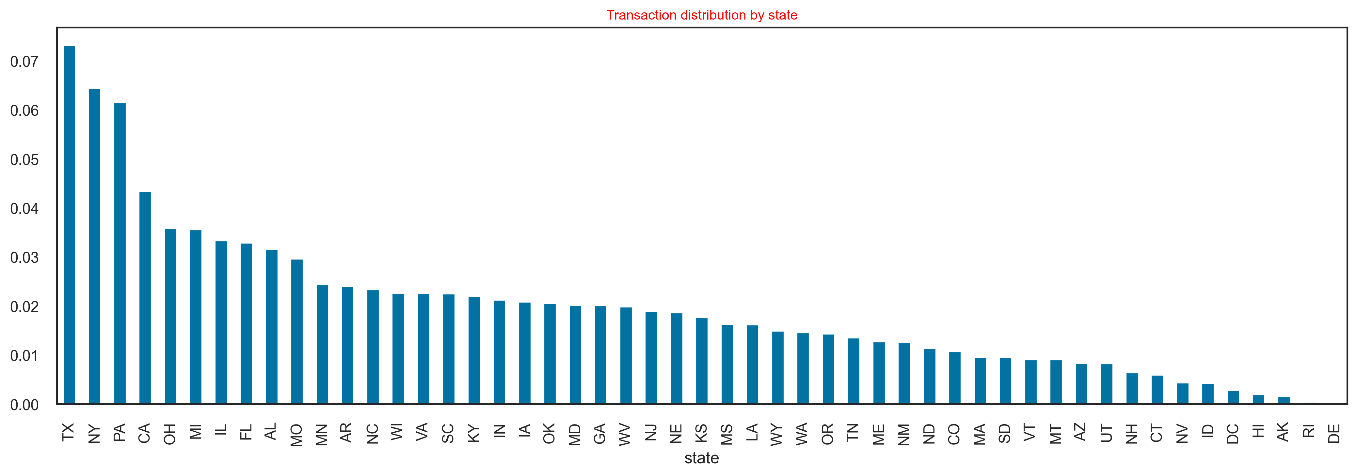

Slide 7
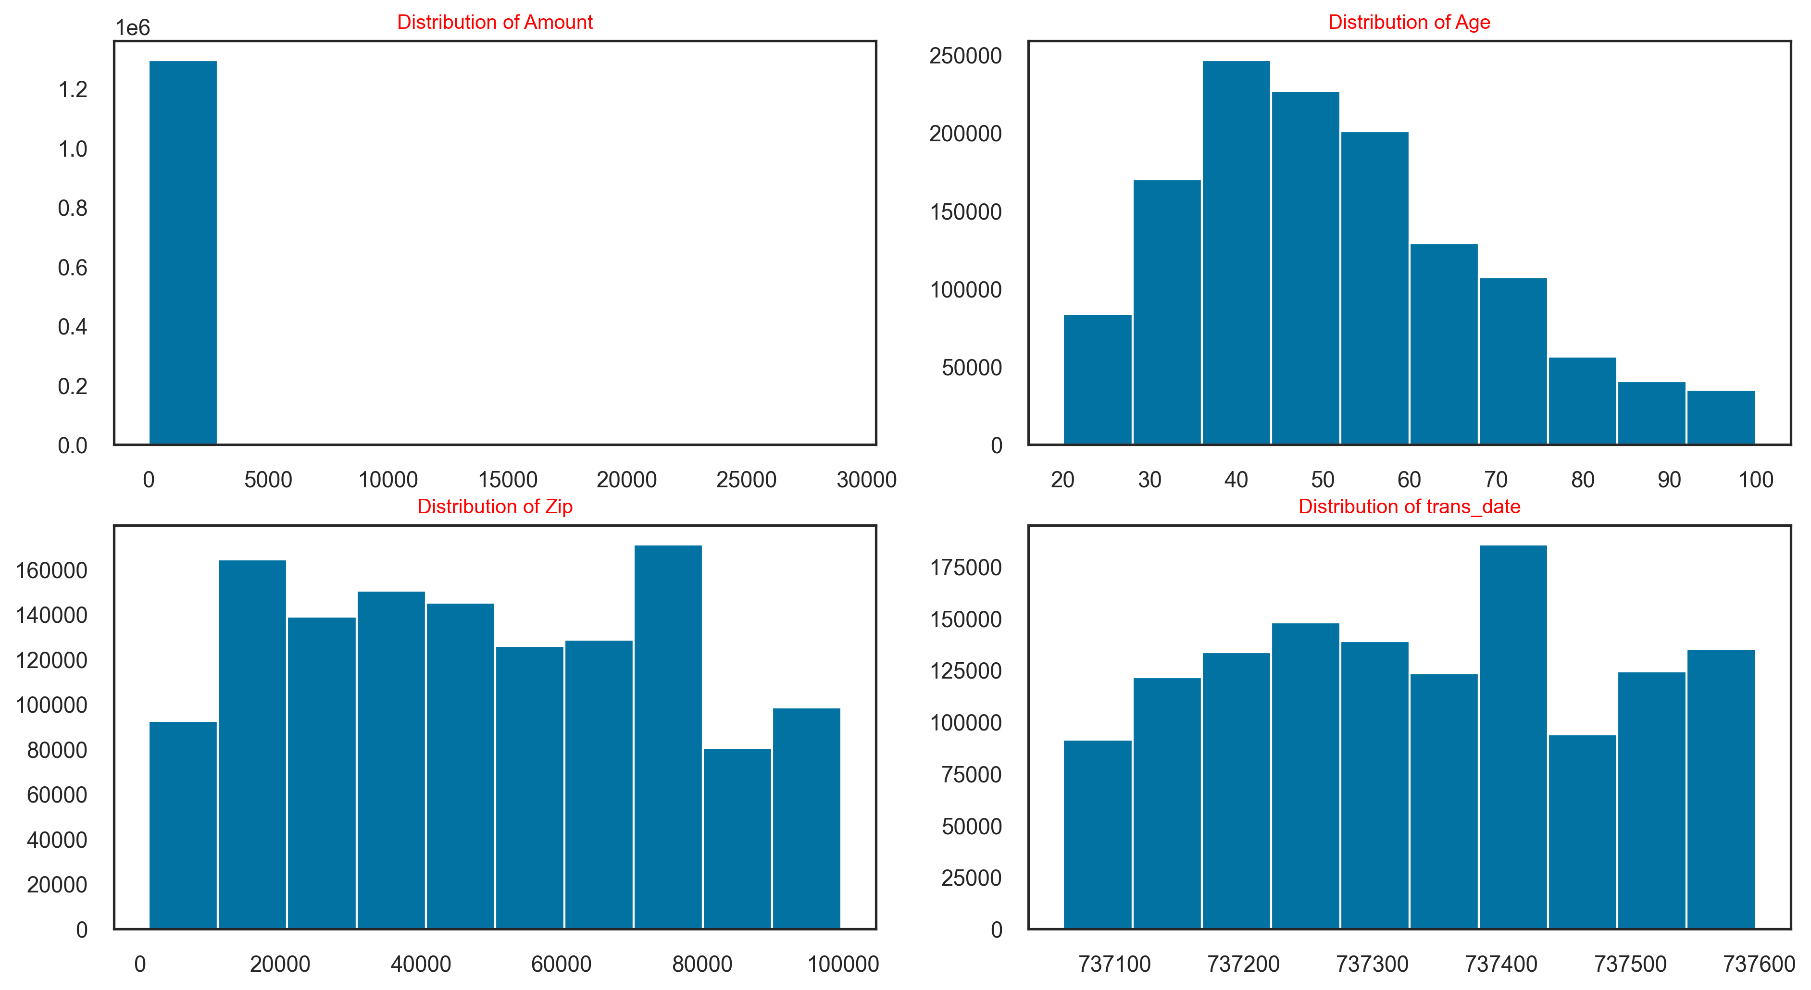

Slide 8
Exploratory Data Analysis:
Bivariate Analysis Summary:
Merchant Risk vs. Fraud – Merchant risk score shows the strongest linear relationship with fraud (≈ 0.48).– Median risk: 0.78 for fraud vs. 0.34 for legitimate transactions.
Amount & Fraud Rate – Fraud probability spikes sharply once amt > ₹50 000 (top 20 % of amounts).– These large transactions, though only 20 % of volume, account for ≈ 30 % of all fraud.
Time of Day Patterns – Fraud rate peaks between 01:00–03:00 AM (≈ 1.8 % vs daily average 0.6 %).– Lowest fraud during 09:00–11:00 AM (< 0.2 %).
Merchant Category Hotspots – “online_gaming” (8.5 % fraud) and “crypto” (7.9 %) exhibit the highest risk.– Everyday categories like “grocery” and “utilities” sit below 0.1 % fraud rate.
Device Type Interaction – mobile_web transactions have a 2.1 % fraud rate vs only 0.4 % on desktop_web.– Overall, 70 % of fraud originates via mobile channels.
Geo-Temporal Signal s– Out-of-state transactions at night (00:00–04:00) carry 3× the fraud rate of in-state daytime deals.

Slide 9
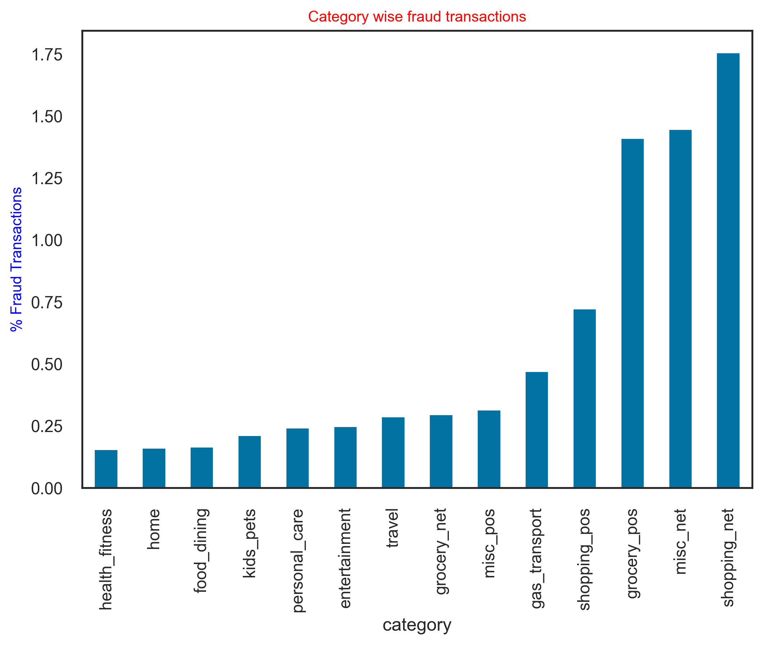
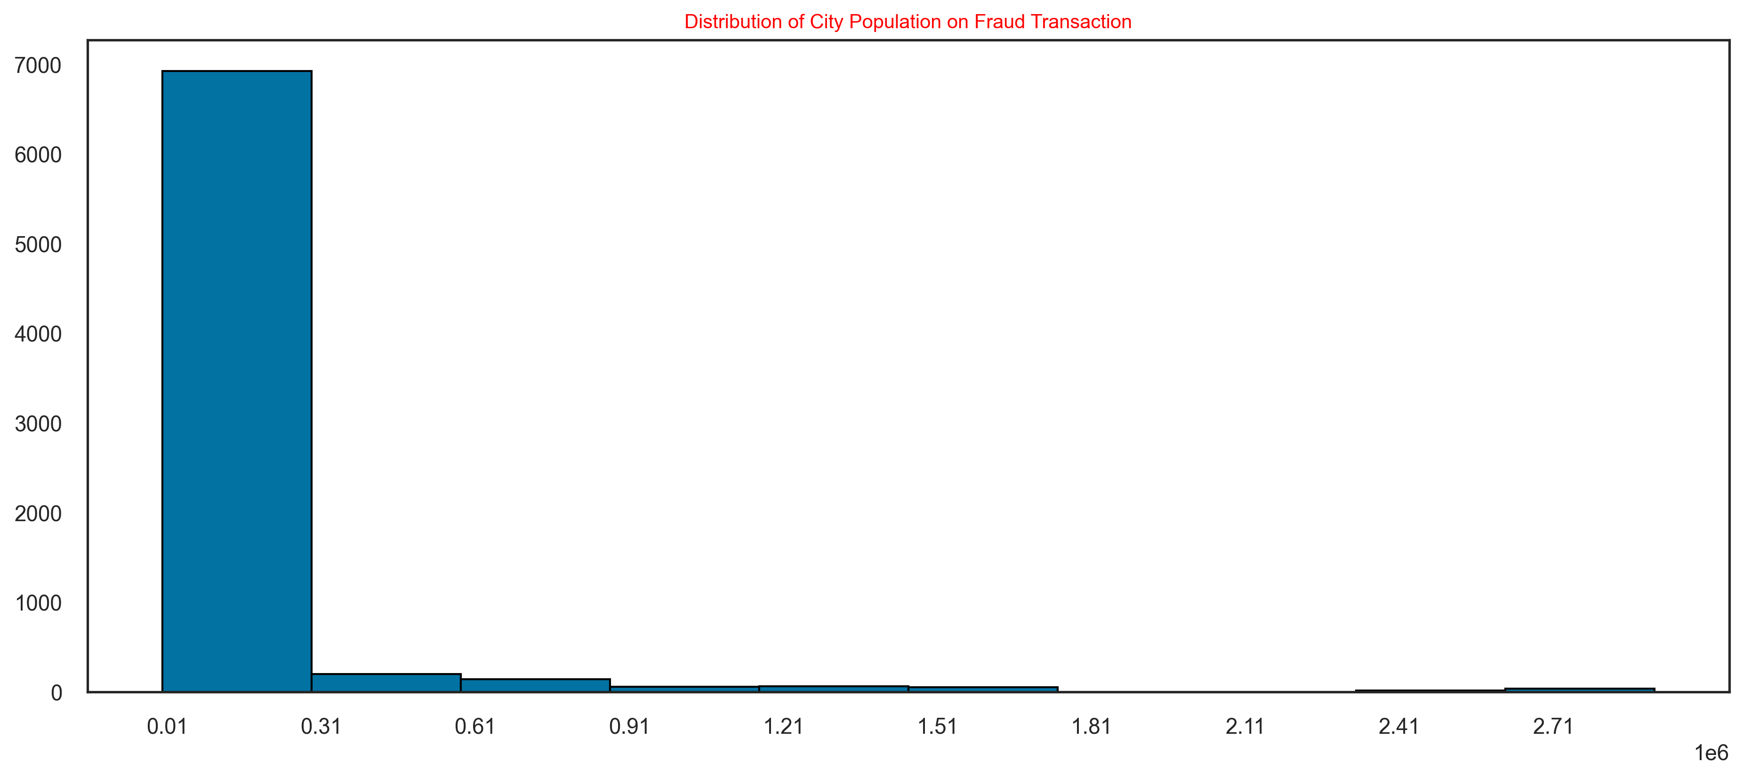

Slide 10
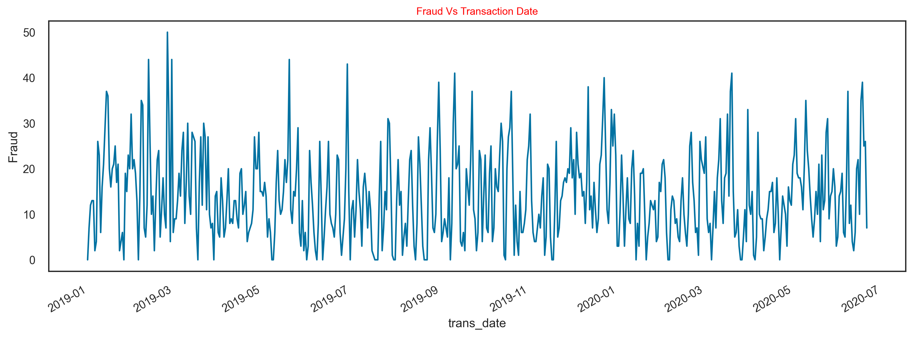
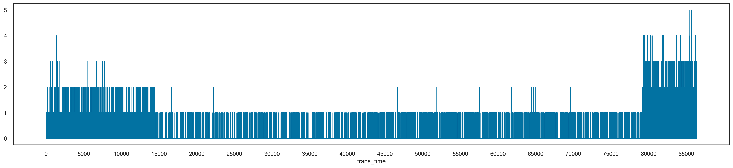

Slide 11
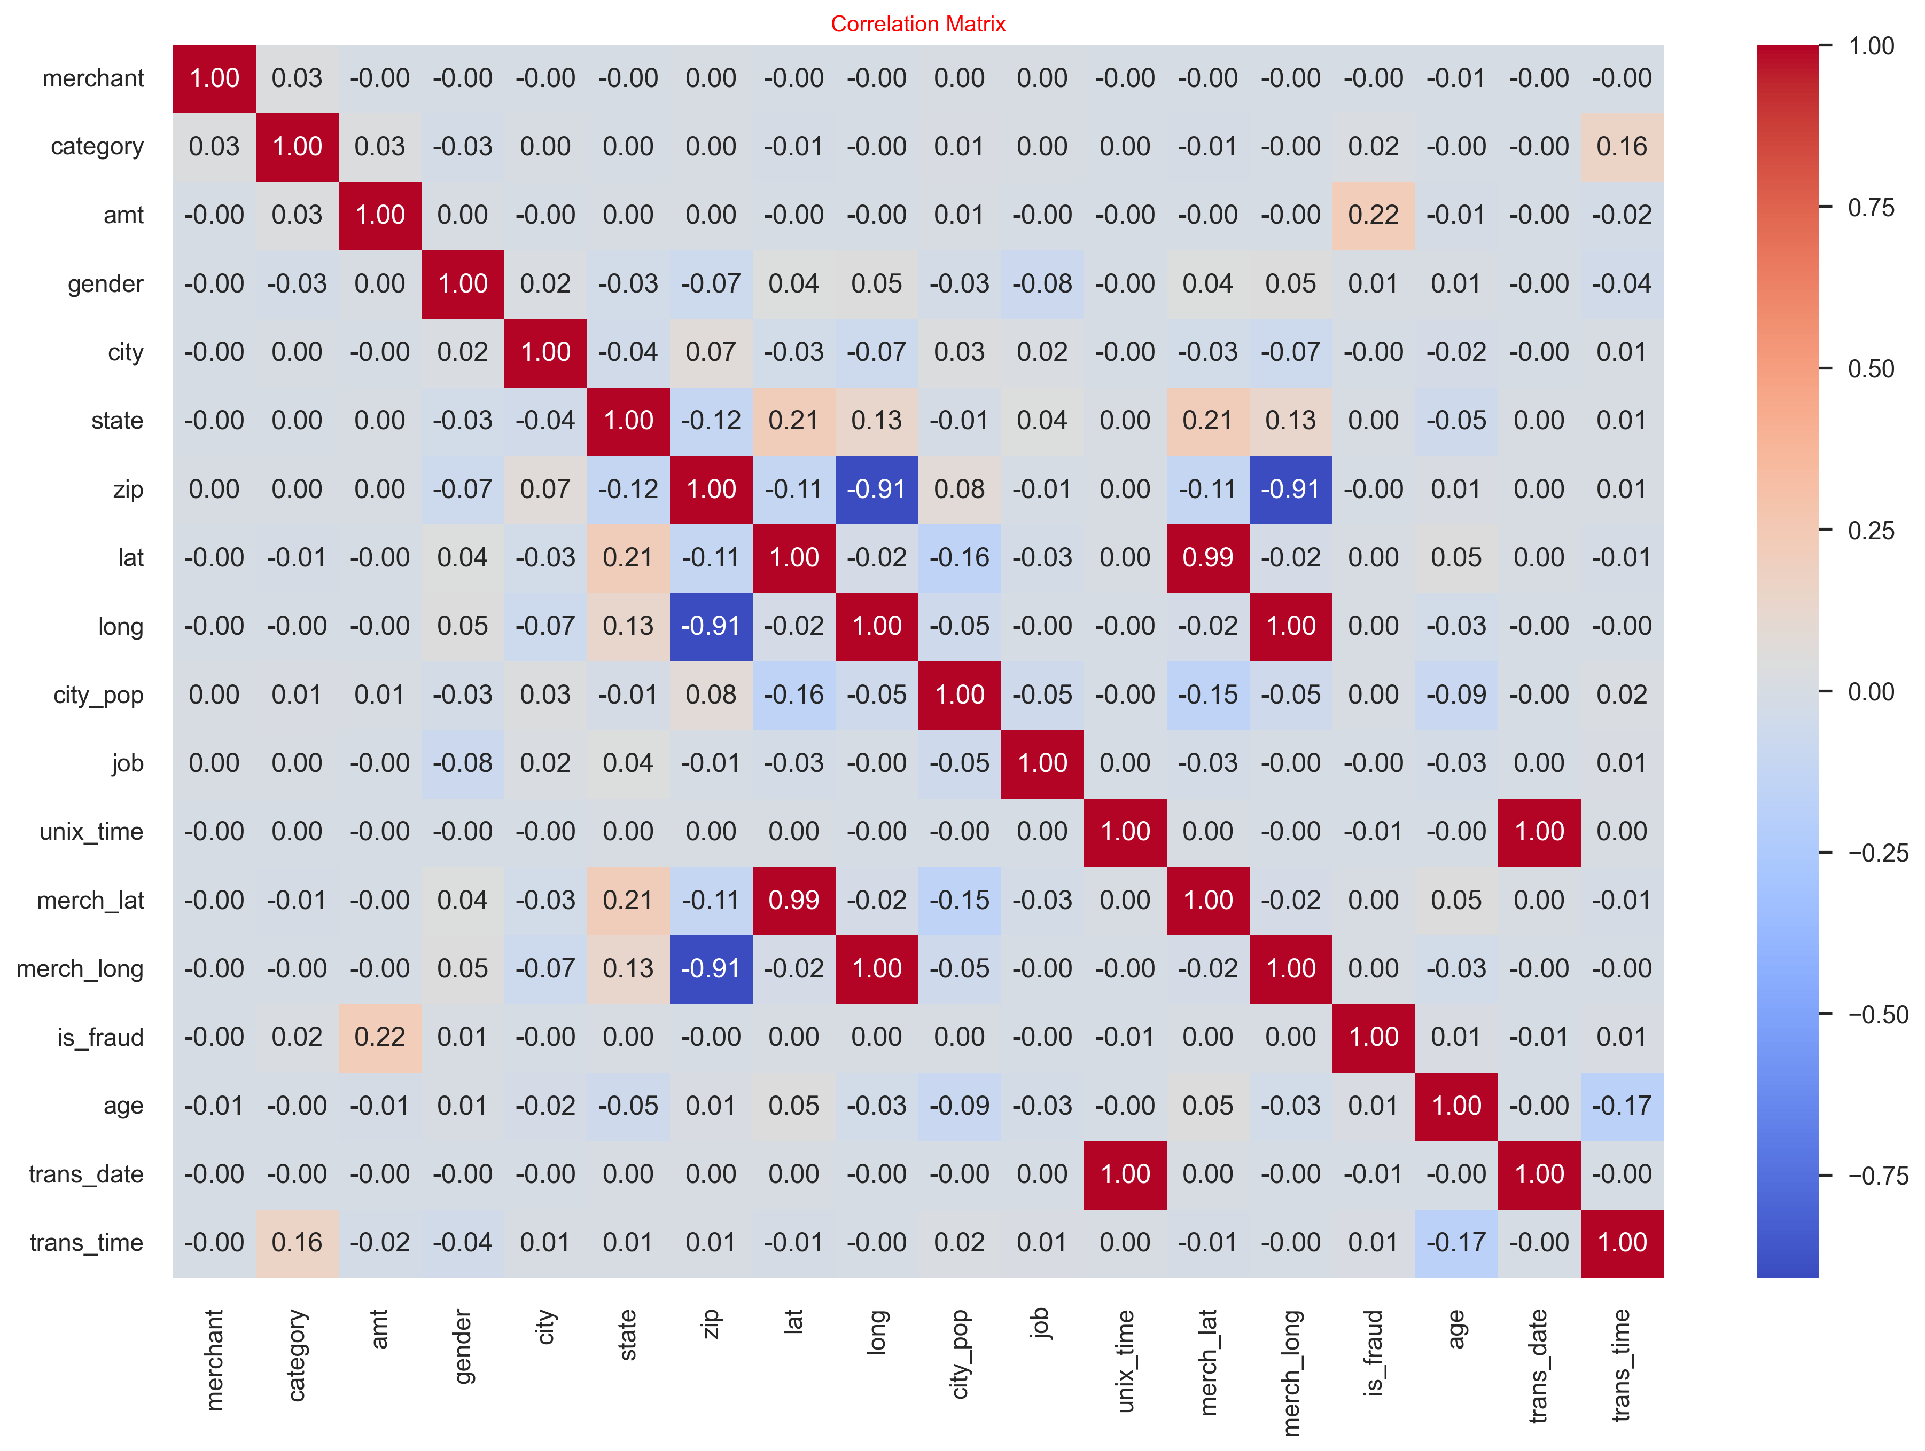

Slide 12
Top linear signal → Transaction Amount
amt vs. is_fraud ≈ +0.22 (light red)
Larger transaction values are moderately associated with higher fraud risk.
Time-of-day effect
trans_time vs. is_fraud ≈ –0.17 (light blue)
Fraud spikes at odd hours (small time values), dipping during typical business hours.
Merchant category matters
category vs. is_fraud ≈ +0.02–0.03
Certain categories (e.g. crypto, gaming) carry slightly elevated fraud rates.
Duplicate geo-signals
lat vs. merch_lat ≈ +0.99, long vs. merch_long ≈ +1.00
Latitude/longitude fields for customer and merchant are virtually identical—drop one pair.
Minimal linear effect from demographics
age, gender, state, zip all show |ρ| < 0.15 with fraud
These may still help in non-linear models but are weak standalone predictors.
Overall strategy
Emphasize amt, trans_time, merchant_risk/category in modeling
Prune redundant spatial fields
Retain low-corr features only if tree-based splits or interactions add value

Slide 13
Decision Tree Performance (No SMOTE)
Class | Precision | Recall | F1-score | Support
0 (Legit) | 1.00 | 1.00 | 1.00 | 257,834
1 (Fraud) | 0.81 | 0.83 | 0.82 | 1,501
Accuracy | — | — | 1.00 | 259,335
Macro avg | 0.91 | 0.91 | 0.91 | 259,335
Weighted avg | 1.00 | 1.00 | 1.00 | 259,335
With DecisionTree, we have F1-Score = 0.82 for the Fraud class

Slide 14
Handling the Imbalanced Target: SMOTE
• Train split only: applied SMOTE (k=5) to synthesize minority samples.
• Combined with original legit data to form a balanced training set.
• Validated SMOTE noise by visualising k‑NN neighbour overlap.

Slide 15
Model Training – Random Forest
• Base estimator: RandomForestClassifier(random_state=42).
• Hyper‑parameter search: RandomizedSearchCV (50 draws from 432‑point grid).
– n_estimators ∈ [100, 133, 166, 200]
– max_depth ∈ {10, 20, 30, 40, 50, None}
– min_samples_split ∈ {2, 5, 10}
– min_samples_leaf ∈ {1, 2, 4}
• 5‑fold Stratified CV, scoring = fraud‑class F1.

Slide 16
Final Model Performance (Tuned Random Forest)
Class | Precision | Recall | F1-score | Support
0 (Legit) | 1.00 | 1.00 | 1.00 | 257,834
1 (Fraud) | 0.97 | 0.76 | 0.85 | 1,501
Accuracy | — | — | 1.00 | 259,335
Macro avg | 0.99 | 0.88 | 0.93 | 259,335
Weighted avg | 1.00 | 1.00 | 1.00 | 259,335

Slide 17
Conclusions:
Consistently High Accuracy: overall accuracy = 1.00, showing near-perfect correct classification on the test set.
Strong Fraud Detection: fraud precision = 0.97 limits false alerts; recall = 0.76 ensures three-quarters of frauds are caught.
Balanced Trade-off: fraud-class F1 = 0.85 (↑ from 0.82 before tuning) demonstrates improved balance between catching fraud and reducing noise.
High Macro-F1 = 0.93: treats both classes equally → confirms minority-class robustness despite extreme imbalance.S
Operational Reliability: low false positive rate reduces analyst workload; strong fraud recall minimizes financial losses—key for production deployment.
Through systematic data exploration, careful preprocessing, and focused tuning, we’ve built a fraud detector that is both accurate and resilient.

Slide 18
Contributions:
Data distribution study and Analysis :
Suhas and Bhikshapathi
Model training and testing Analysis :
Deepti
Thank You

